Slide 1
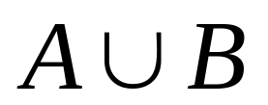
Closure under Union
Theorem: If A and B are regular languages, then
is also regular language
Proof.
Let A be accepted by finite automata N1, and
B be accepted by finite automata N2
Find another finite automata N to accept

Slide 2

Construct N
N1:
N2:

Slide 3


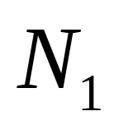
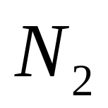
Construct N
N accepts iff one of N1 and N2 accepts

Slide 4
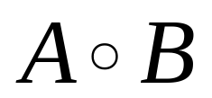
Closure under Catenation
Theorem: If A and B are regular languages, then
is also a regular language
Proof.
Let A be accepted by finite automata N1, and
B be accepted by finite automata N2
Find another finite automata N to accept

Slide 5
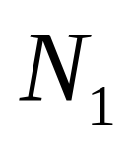
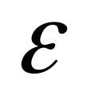
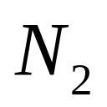
Construct N
N2 is linked to the accept state of N1

Slide 6

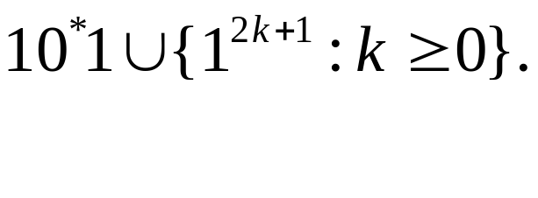
Problem
Design an automata for 10*1.
Design an automata for recognizing all strings
Link the above two automatas for recognizing

